Slide 1
Intelligentcontract Walk Through
Making Healthcare Safer

Slide 2
The intelligentcontract Platform at a Glance
Contract Lifecycle Management
Implementation & Support
Integrations
Advanced, Google-like Search & Filtering
Configurability, Visibility & Security
Automated Workflow to review/approve/update
Reporting/Analytics
Contract Creation, On-line Redlining & Document Coediting
Contract Reminders/Alerts
Dedicated Team to Ensure Success (Healthcare Focus)
Software Best Practices
Guided Implementation & Training
Mass Document/Data Import
Chat, Email, Ticketing & support site
Cloud Hosted with Ongoing Updates & Enhancements
Quarterly Update Webinars
eSignature via DocuSign or Adobe Sign & EverSign
Single Sign on via SAML 2.0, O365/Azure, Google login & OneLogin
Share data with 3rd Party Finance, ERP, & CRM Systems
Hyperlink Contracts to Policies & Procedures

Slide 3
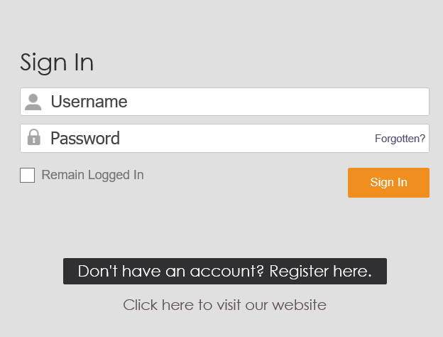
Login
Log in to intelligentcontract using any device with an internet connection
Want your own login portal? We can offer you a custom portal using your own brand colors and logo.

Slide 4
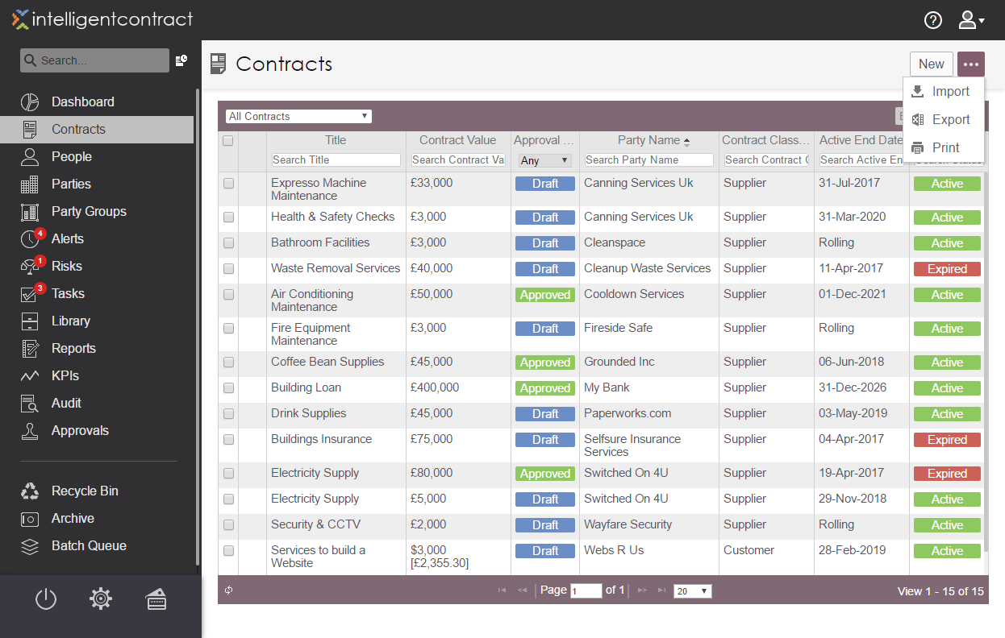
Everything in one place
Select a Pre-Defined View
Filter Quickly
Powerful
Search Tool
Export Easily
Archive Records
Everything you need in a central repository. Find your contract information in a flash and keep on top of your costs.
Notes:
Show approvals
Show menu tabs
Point out views

Slide 5
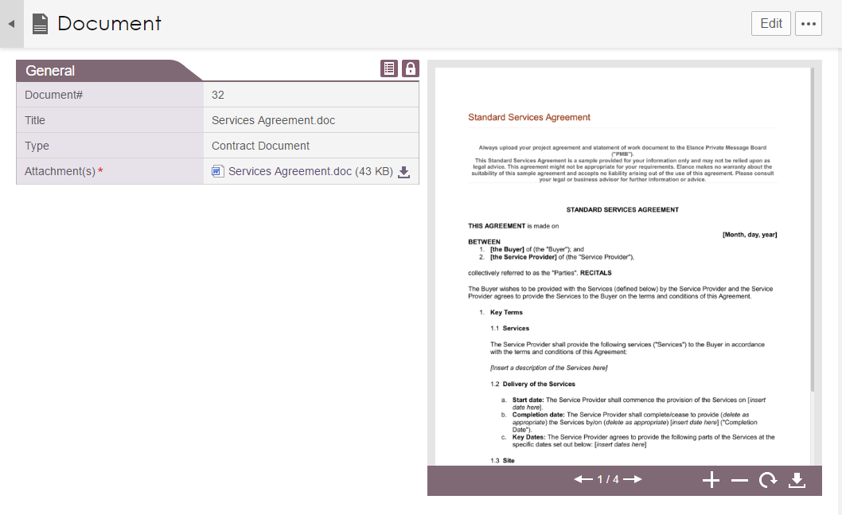
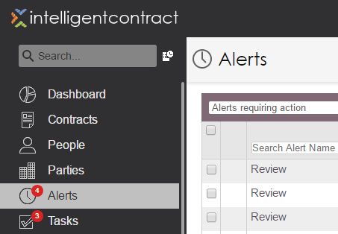
Add Documents and Alerts
Add Alerts to contracts and link the relevant people
Add contract documents to your record
Add one time or recurring Alerts to your contracts.
Never get caught with roll-overs again.
Add contract paperwork and have all your paperwork in one accessible place.
Find that document fast!

Slide 6
Manage renewals and extensions
Track contract amendments
intelligentcontract can help you manage contract renewals, cancellations, change requests and extensions – all in one place.

Slide 7
Electronic signatures
Seamless integration with Adobe Sign® & DocuSign allows you to get documents signed using e-signature technology.
Notes:
Do approvals as a separate step

Slide 8
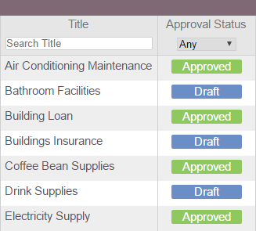
Approvals
Quickly review a contracts approval status
Contracts can be optionally sent for internal approval. Create the chain for approval, track progress and see the approval history right against the contract.
Decide which contracts are subject to approval and which aren't.
When required, admin users can override the approval process and move it along.
Use your mobile phone to approve or reject approval requests.
Notes:
Do approvals as a separate step

Slide 9
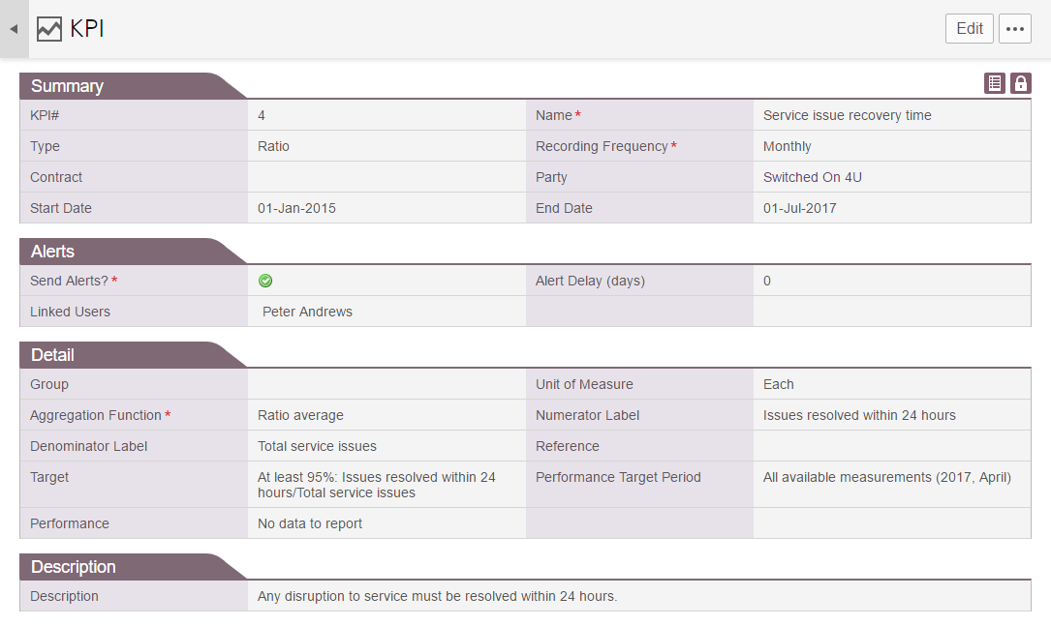
Supplier management and KPIs
Flexibly Set up and measure Supplier KPIs
Set up a custom method for measuring performance
Set up and manage suppliers and associated KPIs.
All the benefits of KPIs without the effort - Suppliers will get an email that requests and allows them to enter KPI data

Slide 10
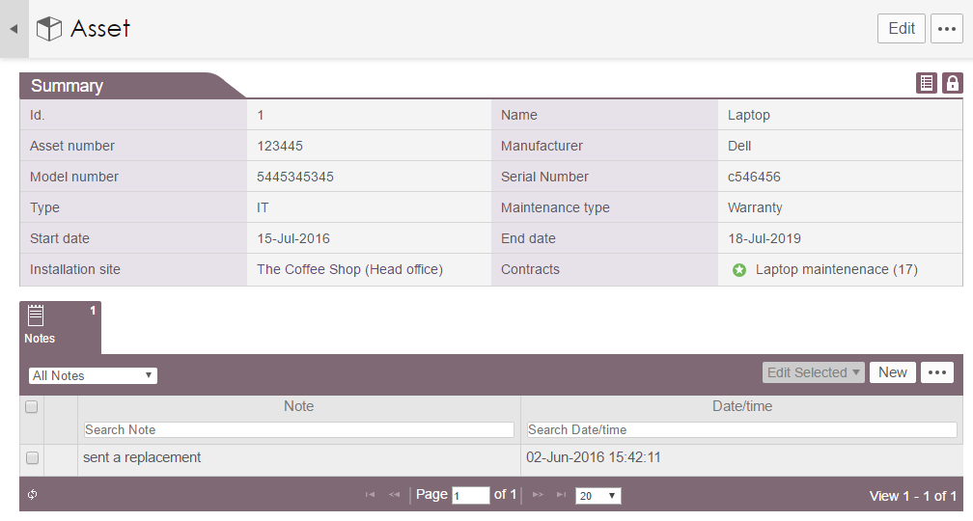
Asset management
Link assets to the relevant contracts for quick and easy lookup
Keep track of the status of your assets
Associate assets to a contract to track and maintain warranty and maintenance contracts.
Have the correct data to hand to quickly and easily inform suppliers of issues.

Slide 11
Build custom reports
Use the tools to Order, Rename, Filter and Sort your data
Preview your Report before creation
intelligentcontract allows the creation of custom reports that can be built to meet your exact requirements and then shared with all your users. Once defined, reports can be run with different parameters and delivered in either a Microsoft Excel or PDF format.

Slide 12
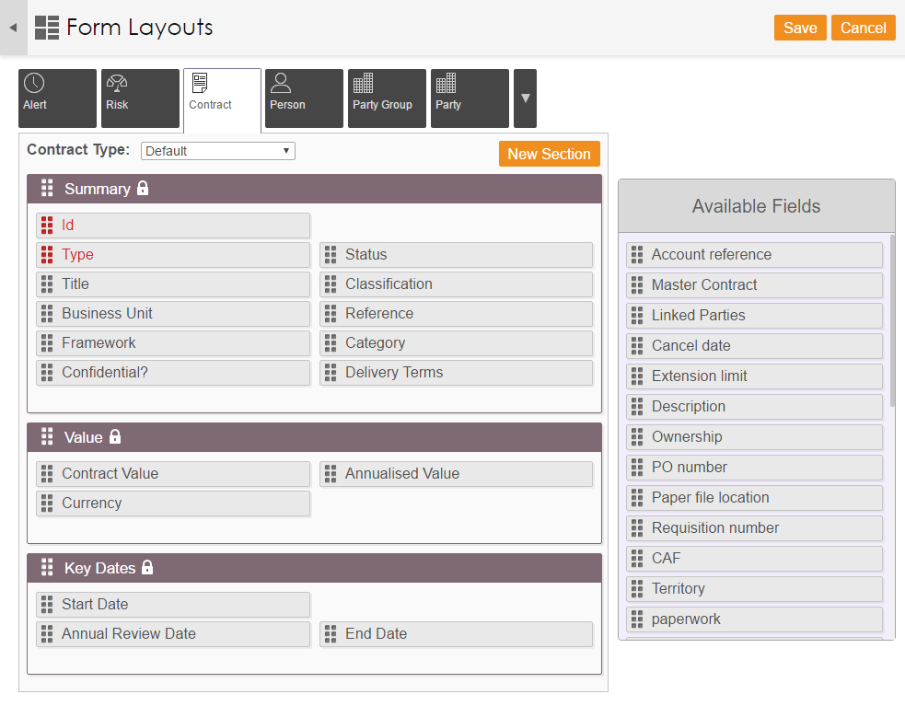
Customise and personalize
Set layouts for each contract type
Display only the fields you need
Drag-and-drop to create the layout you need
Custom fields can be added to capture data which is specific to your organisation.
Different custom fields can optionally be defined for each contract type. Existing and new custom fields can be placed exactly where required.
Existing fields can be removed, renamed or made mandatory.
The resulting solution will match your organisation's process and terminology exactly.

Slide 13
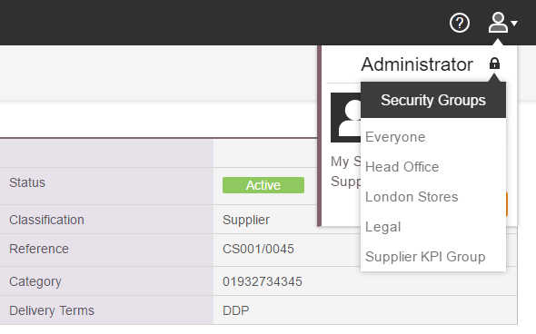
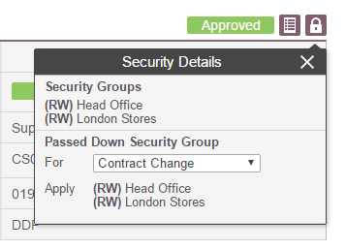
Security
Only users with the correct security can gain access to the contract
Set up simple or complex rules
A fully flexible security model is available with intelligentcontract.
Only users who are part of the correct security group can view
contracts assigned to that group.
Read-only users can optionally be set up

Slide 14
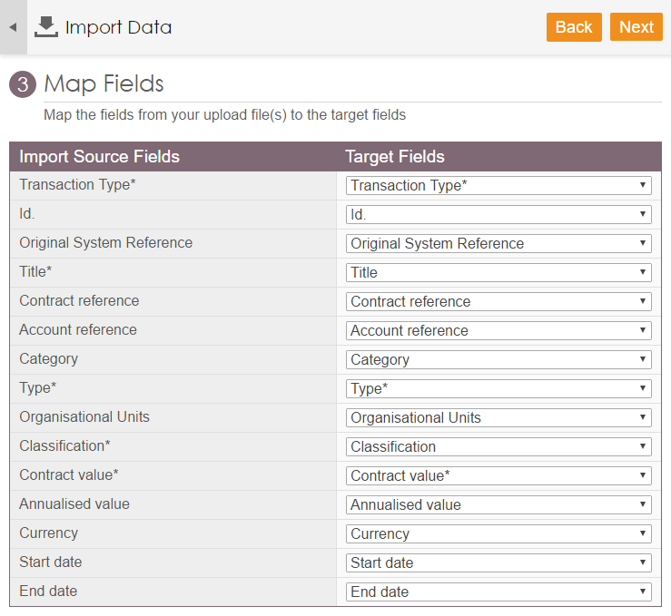
Import your existing records
Map excel columns to fields to import your data easily
intelligentcontract provides tools to import contracts, documents, people
or companies from a spreadsheet.

Slide 15
Audit log
See which users are updating records…
…and what has been changed
intelligentcontract.com provides an audit trail of each change made to your data. Nothing can be added, deleted or edited without the system recording the change. Audit records can be reviewed to see who made the changes, when they were made and the specific nature of the change.

Slide 16
Best Practice Methodology - intelligentcontract
Implementation methodology and processes are based on years of experience, successful customer deployments
Depth and breadth of team experience implementing CLM systems
Focused Outcomes
Gain visibility to existing contracts
Reduce contract cycle time
Achieve compliance with contract obligations
Intelligentcontract configuration based on best practice contract management disciplines
Rapid time to value
Optimal adoption
Sustainable self-maintenance

